Slide 1
insights from DEDAT SURVEY on “Impact of taxi violence on business activity in the western cape”
DEDAT REPP Unit

Slide 2
Content
Introduction
Summary of survey results
Industry overviews
Selected comments
Source: News 24

Slide 3
Introduction
A DEDAT Snap Survey was conducted to gauge the level of disruption to Western Cape businesses caused by the recent spate of taxi violence
This survey report is based on 594 responses received by the 11th of August 2023
400,000 employees are represented by the respondents, including 64 industry bodies
Source: Daily Maverick

Slide 4
Results: overall impact
Notes:
Introduction
Like the rest of South Africa, the Western Cape faces a range of deep, interconnected, socio-economic challenges that include unemployment, poverty and crime. While there is no panacea for these challenges, which have deep roots in the country’s history and social structure, there is also no prospect of addressing any of them without faster economic growth. Economic growth is essential to generating rapid and sustained job creation, faster growth in living standards and increased resources available to society. The Western Cape Government identified the need for a strategy to lift dramatically the provincial growth rate and, to the extent that growth continues to falter in South Africa, to decouple the province’s growth trajectory from that of the rest of the country.
Therefore, this Growth for Jobs Strategy sets out a comprehensive, challenging and ambitious goal for the Western Cape to grow its economy by between 4 and 6% by 2035.
It is also a strategy that clarifies that how we grow our economy is as important as the growth itself. In this way, the Growth for Jobs Strategy distinguishes itself from previous strategies, by providing a long-term perspective with clear targets, framed within defined principles. It is centred on systemic solutions that address key binding constraints and an enabling environment for the private sector that accelerates our economic growth.
The formulation of the Growth for Jobs Strategy has been data-driven, evidence-led and has involved extensive consultation. It draws on a provincial Growth Diagnostic completed in 2022 and involved a team of officials and independent experts who engaged with stakeholders from the private and public sectors, and representatives from across civil society and academia.
The Growth for Jobs Strategy process drew from three surveys that were conducted and disseminated through private-sector channels, drawing in the views of over 540 stakeholders. Furthermore, during the strategy formulation process, the Western Cape Government consulted over 2000 people and industry representatives (and their constituents representing more than 30 000 individuals) over the course of 188 engagements.
At its heart, the Growth for Jobs Strategy is premised on a recognition that the private sector creates jobs, while the State needs to create an environment in which people and businesses are enabled to create and exploit opportunities as they arise. This kind of ‘horizontal’ enablement empowers citizens and fosters independence, freedom, and self-reliance.
To give effect to this approach, the Growth for Jobs Strategy has several important anchors:
Clear principles set out in a strategic framework that have guided thinking and decisions.
Crucial priority focus areas (PFAs) that shape decisions around the nature of the interventions needed to maximise impact.
Key levers, enablers and accelerators that facilitate the achievement of these goals.
Finally, the Growth for Jobs Strategy is a whole-of- government, all-of-society strategy whose success requires the energy, commitment and allocation of resources from across government, the private sector and civil society.

Slide 5
Summary of overall impact
75% of respondents state that more than 50% of their workers were impacted by the ongoing taxi strike

Slide 6
Summary of overall impact
69% of respondents lost out on income as a result of the transport disruptions
32% of respondents lost more than 50% of their daily income

Slide 7
Summary of overall impact
62% of participants managed to sustain their day-to-day activities despite the disruptions, while 38% of respondents indicated that they couldn't maintain their usual operations due to these disruptions

Slide 8
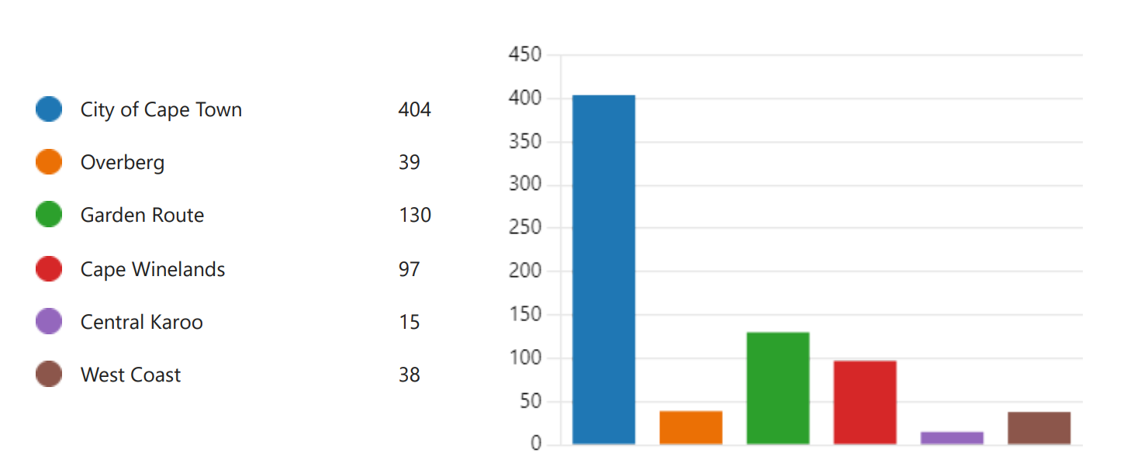
Location of most respondents and their workers
In response to the question “Where are your main business operations located?” the following key words appeared most often

Slide 9
Location of most respondents and their workers
In response to the question “If your employees have been negatively impacted, which areas/suburbs are they traveling from?”, the following key words appeared most often

Slide 10
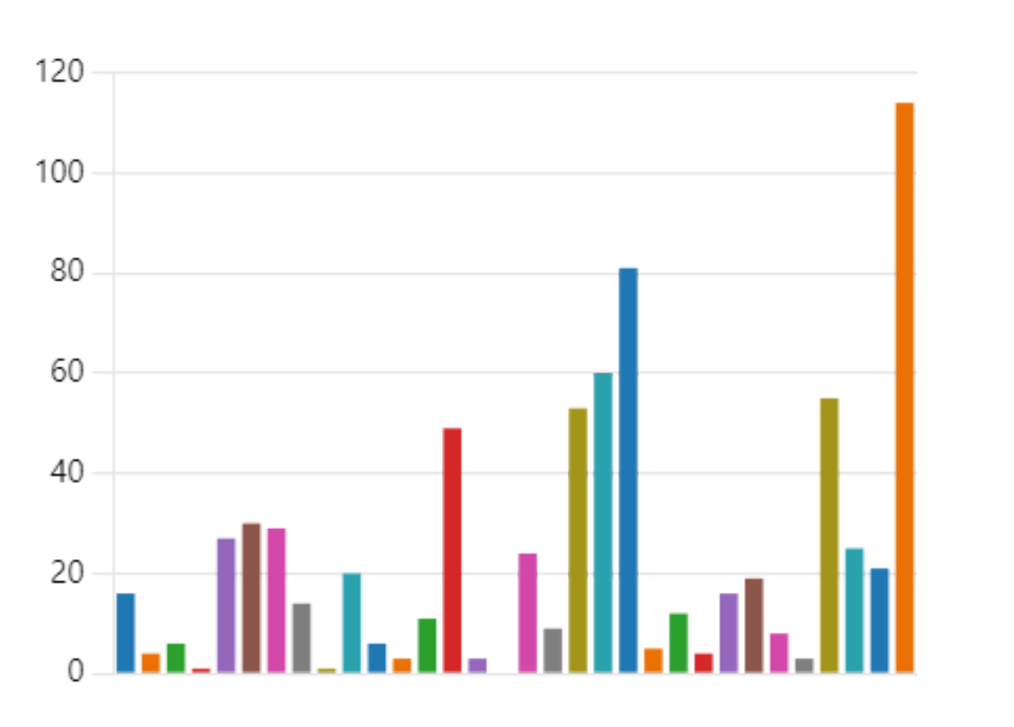
Most affected industries
In response to the question “What industry do you fall under?”, the following industries appeared most often
Other 114
Hotels and restaurants 81
Sale & Repairs of Motors 60
Education 55
Retail trade and repairs 53
Furniture and other items 49
Textiles, clothing and leather 30
Wood and wood products 29
Food Beverages and tobacco 27

Slide 11
Overview of key industries impacted
Notes:
Introduction
Like the rest of South Africa, the Western Cape faces a range of deep, interconnected, socio-economic challenges that include unemployment, poverty and crime. While there is no panacea for these challenges, which have deep roots in the country’s history and social structure, there is also no prospect of addressing any of them without faster economic growth. Economic growth is essential to generating rapid and sustained job creation, faster growth in living standards and increased resources available to society. The Western Cape Government identified the need for a strategy to lift dramatically the provincial growth rate and, to the extent that growth continues to falter in South Africa, to decouple the province’s growth trajectory from that of the rest of the country.
Therefore, this Growth for Jobs Strategy sets out a comprehensive, challenging and ambitious goal for the Western Cape to grow its economy by between 4 and 6% by 2035.
It is also a strategy that clarifies that how we grow our economy is as important as the growth itself. In this way, the Growth for Jobs Strategy distinguishes itself from previous strategies, by providing a long-term perspective with clear targets, framed within defined principles. It is centred on systemic solutions that address key binding constraints and an enabling environment for the private sector that accelerates our economic growth.
The formulation of the Growth for Jobs Strategy has been data-driven, evidence-led and has involved extensive consultation. It draws on a provincial Growth Diagnostic completed in 2022 and involved a team of officials and independent experts who engaged with stakeholders from the private and public sectors, and representatives from across civil society and academia.
The Growth for Jobs Strategy process drew from three surveys that were conducted and disseminated through private-sector channels, drawing in the views of over 540 stakeholders. Furthermore, during the strategy formulation process, the Western Cape Government consulted over 2000 people and industry representatives (and their constituents representing more than 30 000 individuals) over the course of 188 engagements.
At its heart, the Growth for Jobs Strategy is premised on a recognition that the private sector creates jobs, while the State needs to create an environment in which people and businesses are enabled to create and exploit opportunities as they arise. This kind of ‘horizontal’ enablement empowers citizens and fosters independence, freedom, and self-reliance.
To give effect to this approach, the Growth for Jobs Strategy has several important anchors:
Clear principles set out in a strategic framework that have guided thinking and decisions.
Crucial priority focus areas (PFAs) that shape decisions around the nature of the interventions needed to maximise impact.
Key levers, enablers and accelerators that facilitate the achievement of these goals.
Finally, the Growth for Jobs Strategy is a whole-of- government, all-of-society strategy whose success requires the energy, commitment and allocation of resources from across government, the private sector and civil society.

Slide 12
Overview: Food, Beverages, and Tobacco Products Industry
91% of respondents have been affected by the taxi strike
87% of respondents have lost revenue, with 57% losing up to 50% or more of daily income
57% of respondents were not able to continue day-to-day business
38% of respondents had up to 100% of their business activities disrupted
Industry bodies respondents represented 45,000 employees
Overview: Retail Trade and Repairs of Goods Industry
100% of respondents have been affected by the taxi strike
45% the respondents reported that over 50% of their staff were affected by the taxi strikes
90% of respondents have lost income; half lost more than 25% of their daily revenue
The respondents employ a collective 20,130 workers across the Western Cape

Slide 13
Overview: Textiles, Clothing, and Leather Products Industry
100% respondents have been affected by the taxi strike
100% respondents reported 100% of their workers have been affected by the taxi strike
78% of the respondents report that they have lost income
41% respondents are able continue their business day to day despite transport disruptions
100% of employees have been affected by the transport disruption over the past few days
Overview: Hotels and Restaurants Industry
100% of respondents have been affected by the taxi strike
100% of respondents reported 93% of their workers have been affected by the taxi strike
79% of the respondents report that they have lost income
73% report that business was able to continue its daily operations despite the disruptions
67% of the respondents reported that about 25% of business activities were disrupted

Slide 14
Summary of results: comments from business leaders
Notes:
Introduction
Like the rest of South Africa, the Western Cape faces a range of deep, interconnected, socio-economic challenges that include unemployment, poverty and crime. While there is no panacea for these challenges, which have deep roots in the country’s history and social structure, there is also no prospect of addressing any of them without faster economic growth. Economic growth is essential to generating rapid and sustained job creation, faster growth in living standards and increased resources available to society. The Western Cape Government identified the need for a strategy to lift dramatically the provincial growth rate and, to the extent that growth continues to falter in South Africa, to decouple the province’s growth trajectory from that of the rest of the country.
Therefore, this Growth for Jobs Strategy sets out a comprehensive, challenging and ambitious goal for the Western Cape to grow its economy by between 4 and 6% by 2035.
It is also a strategy that clarifies that how we grow our economy is as important as the growth itself. In this way, the Growth for Jobs Strategy distinguishes itself from previous strategies, by providing a long-term perspective with clear targets, framed within defined principles. It is centred on systemic solutions that address key binding constraints and an enabling environment for the private sector that accelerates our economic growth.
The formulation of the Growth for Jobs Strategy has been data-driven, evidence-led and has involved extensive consultation. It draws on a provincial Growth Diagnostic completed in 2022 and involved a team of officials and independent experts who engaged with stakeholders from the private and public sectors, and representatives from across civil society and academia.
The Growth for Jobs Strategy process drew from three surveys that were conducted and disseminated through private-sector channels, drawing in the views of over 540 stakeholders. Furthermore, during the strategy formulation process, the Western Cape Government consulted over 2000 people and industry representatives (and their constituents representing more than 30 000 individuals) over the course of 188 engagements.
At its heart, the Growth for Jobs Strategy is premised on a recognition that the private sector creates jobs, while the State needs to create an environment in which people and businesses are enabled to create and exploit opportunities as they arise. This kind of ‘horizontal’ enablement empowers citizens and fosters independence, freedom, and self-reliance.
To give effect to this approach, the Growth for Jobs Strategy has several important anchors:
Clear principles set out in a strategic framework that have guided thinking and decisions.
Crucial priority focus areas (PFAs) that shape decisions around the nature of the interventions needed to maximise impact.
Key levers, enablers and accelerators that facilitate the achievement of these goals.
Finally, the Growth for Jobs Strategy is a whole-of- government, all-of-society strategy whose success requires the energy, commitment and allocation of resources from across government, the private sector and civil society.

Slide 15
Summary: Comments from business leaders
Comments on the by-laws
Business owners are showing strong support for the government’s attempt to uphold the law
A few respondents felt that the government response was too harsh
International investment and tourism:
Many are worried about the impact this may have on tourism and investments
Cape Town has faced reputational damage as respondents in the tourism sector have commented that they have received cancellations from foreign tourists
One international investor explicitly stated his intention to withdraw from South Africa and look towards other African countries as an investment destination
Small towns in the Western Cape are complaining that there are no visitors in sight
The travel warnings from the UK and US was brought up in some responses

Slide 16
Summary: Comments from business leaders
Safety:
Many respondents genuinely fear for their safety when having to travel
Others feel unsafe and are worried about increased crime, calling for more severe police action
Respondents from Knysna complained about the absence of police during the strikes
Wages:
As business owners lose out on profits, less is available for their employees’ salaries
A few businesses indicated their intention to implement a “no work-no pay” system in case the strikes continued
Education
The education sector had many concerns, most of which pertains to the curriculum falling behind
Younger kids who are unable to go to school require their parents to stay at home too (increasing staff absenteeism)

Slide 17
Summary: Comments from business leaders
Transport
Some are expressing interest in alternative transport mediums, i.e., trains, trams, and more bus routes
Interest is not only due to strikes, but stems from a general worry about the safety of passengers
Additionally, some businesses who have their own transport providers were threatened by strikers
Cargo/freight/value chains
Businesses were unable to get their relevant supplies or stock, e.g., bread, delivered
This is especially concerning when hospitals/clinics comment that they are unable to get essential equipment and pharmaceuticals
Additional comments
People are calling for contingency plans in the case of future taxi-related (or other) strikes
Some commented on bad planning to leave the N2, Borcherds Quarry, and Airport Approach open, knowing that the taxis would strike there

