Slide 2
Lending Focus
SMMEs & Co-Operatives
Business phases and financing instruments
Start-up Expansion Acquisition Asset finance Working capital (inventory/stock)
Eligibility Criteria
SA Citizens Registered and operate in South Africa Business plan / profile The majority shareholder as the owner manager of the business Valid Tax Clearance Certificate Compliance with applicable legislation
Economic Merit, Viability & Sustainability

Slide 3
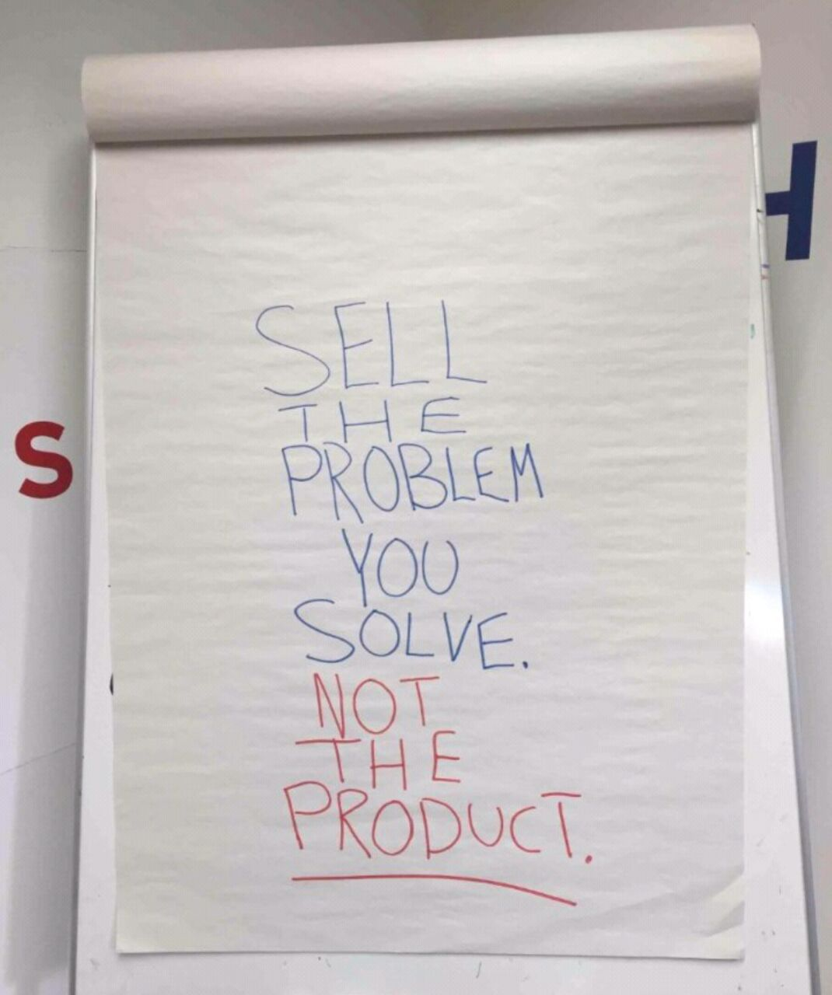

Slide 4
Specialised Funds (Direct Lending)
Amavulandlela Funding Scheme (Disability)
Township and Rural Entrepreneurship Programme (TREP)
Small Enterprise Manufacturing Support Programme (SEMSP)
Youth Challenge Fund (YCF)
Purchase Order Programme (POP)
Energy Relief Programme not launched yet, however energy funding needs are supported under different funds listed above (incl battery systems, generators, solar penals, inverters, etc)

Slide 5
Amavulandlela Funding Scheme
The scheme offer entrepreneurs with disabilities credit facilities (Medical certificate / record provided)
The actual loan duration will be subject to the projected cash flows and viability of the business
Normal sefa loan administration fees will apply
Additional Customised Benefits
Pre-Approval Assistance
Post-Approval Assistance

Slide 6
Township and Rural Entrepreneurship Programme
PROGRAMME OBJECTIVES
Formalize the informal businesses to micro enterprises
Facilitate the banking of the unbanked
Build reliable database for future Government planning and support
Support opportunities for self-employment and job-creation at economic entry level whilst improving the circulation of money within townships and rural areas
Realize potential for spaza shops to serve as market for locally manufactured goods, through an inclusion of products manufactured SMMEs including cooperatives supported by the DSBD portfolio to the supported basket of goods
Create circular economies in Township and Rural areas that are self-sustainable

Slide 7
Small Enterprise Manufacturing Programme
Who can apply (Minimum Qualifying Criteria):
The Programme is targeted at SMMEs with a high developmental impact in the economy
Only SMMEs creating a minimum of 10 jobs and requiring funding over a minimum period of three years will be considered
Focus areas in the Development Impact Scorecard for grant amount determination:
Number of jobs created and/or maintained (i.e. a minimum of 10 jobs required)
More focus on priority target groups
More focus on townships and rural based SMMEs
More focus on the priority sectors (manufacturing/industrial)
Additional Customised Benefits:
Pre-Approval Assistance
Post-Approval Assistance

Slide 8
Youth Challenge Fund
Youth between 18 – 35 years
South African Youth
Actively involve in the day-to-day operations
Prepared to participate in Business Development Support
Commercially viable and sustainable business idea / concept
Registered company (CIPC) and SARS compliant
Additional Customised Benefits:
Pre-Approval Assistance
Post-Approval Assistance

Slide 9
Purchase Order Programme
Viable buy-and-supply purchase orders (Supply/Deliver);
Funding up to R3 million;
Only applicable to short-term funding requirements (up to 12 months);
Imports are excluded.
Critical Requirements:
Application form
Verification of Purchase Order
Cession of payment, Escrow Account (Banks / Attorneys), etc.

Slide 10
Exclusions
The following businesses fall outside the scope of enterprises that we fund:
Manufacturing and selling of ammunition (Arms Industries)
Tobacco, alcoholic beverages, gambling and sex trade (Sin Industries)
Persons under debt review and/or with court judgements
Labor brokers
Insolvent entities

Slide 11
Thank You
Contact Details
Website | www.sefa.org.za
Switch board (Softline) | 012 741 3221 / 012 741 3225
Direct email | violan@sefa.org.za / denicec@sefa.org.za
Online application link | www.sefa.org.za – apply here (pre-screening)
Co-locations | seda offices
Small Enterprise Finance Agency

